Slide 1

Seminar 10
UBIQUITOUS SENSOR NETWORK LABORATORY
Department of Electronics Engineering, Keimyung University
29th July 2016
By Tran Viet Cuong

Slide 2
INDEX
For Exhibition
Prototype
Basic GUI for App
Raspberry + kivy + OpenCV
Rasberry + kivy
OpenCV: Pan Tilt Face Tracking
UBIQUITOUS SENSOR NETWORK LABORATORY

Slide 3
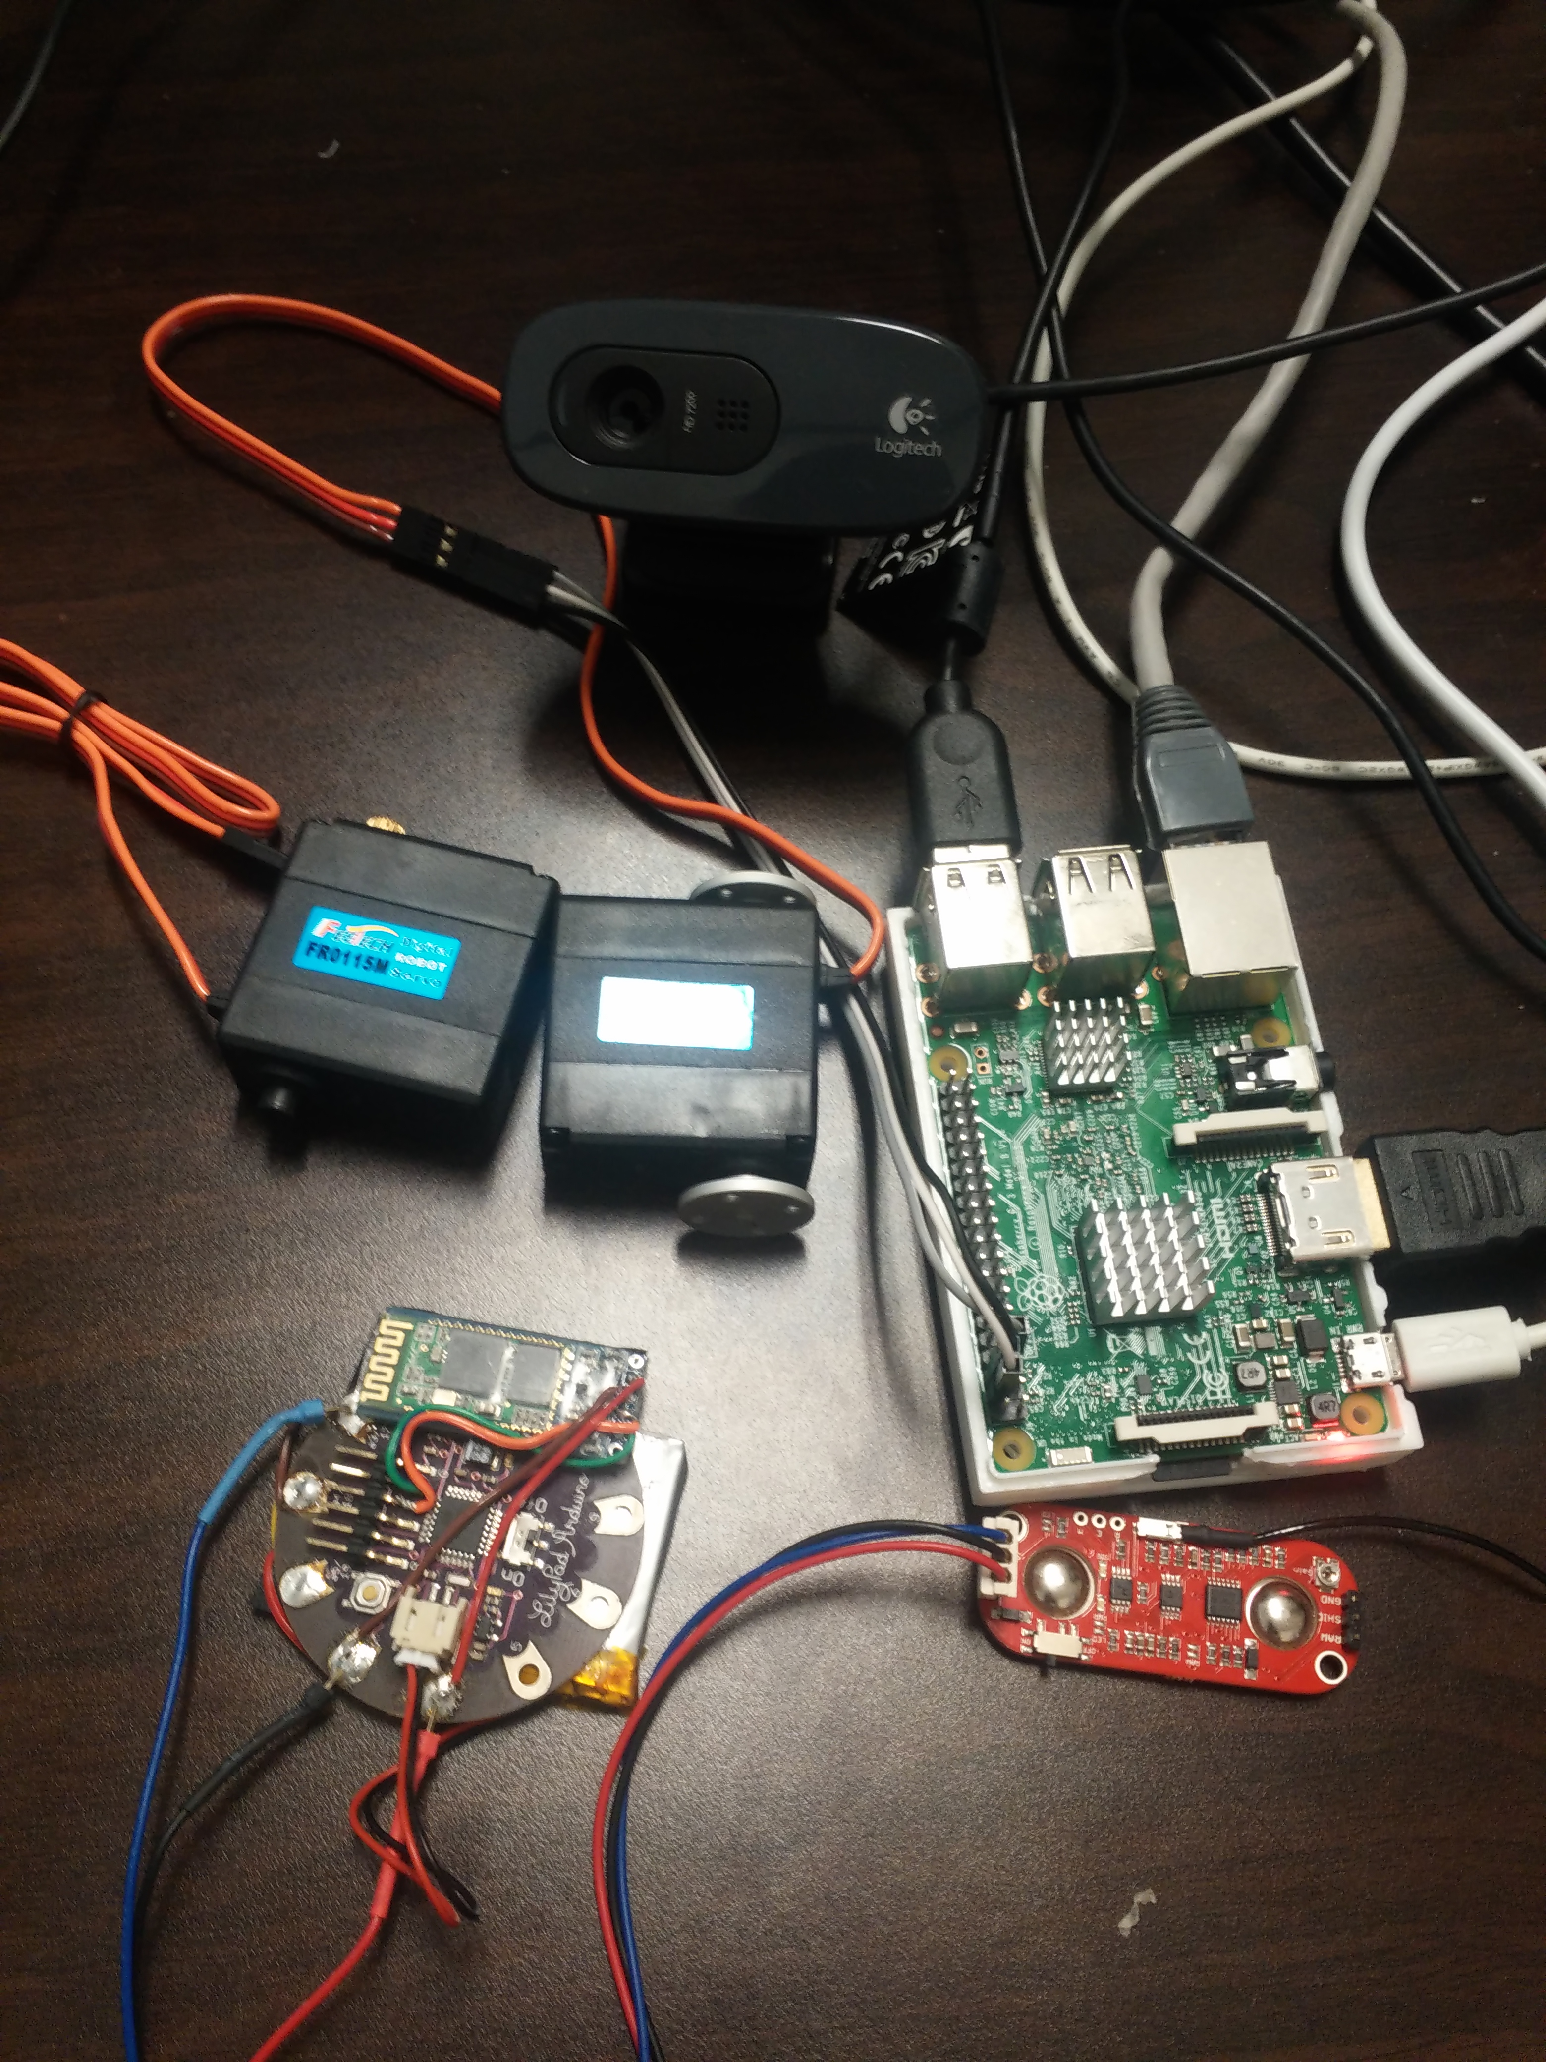
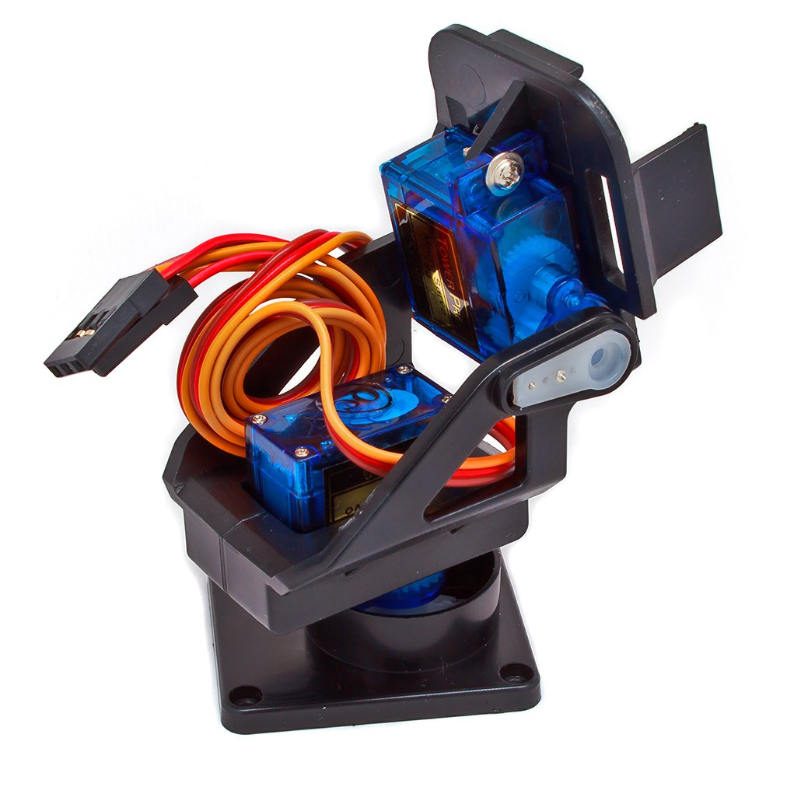
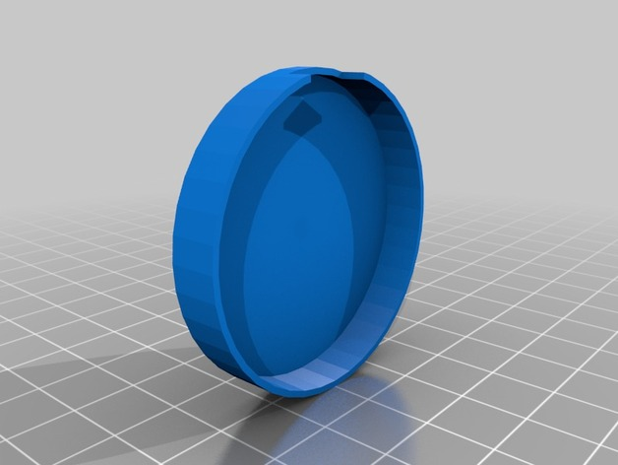
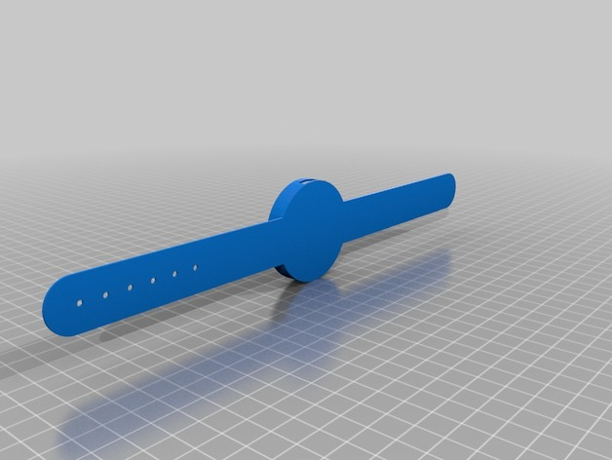
Prototype
LilyPad
Raspi berry 3
EMG: Myo sensor
Bluetooth 2.1: HC-06
IMU
Battery: 3.7V 400mAh (5h)
2 servor motors
Pan and Tilt

Slide 4
GUI Interface and Functions
Idea: Using EMG and IMU to control functions of webcam (camera) (ISO, Shutter, Aperture, Interval for taking time-lapse), direction of camera, and Gallery to watch pictures
There are 2 servo motors to control direction. For automatic, camera will detect face and the direction will follow people face. For manual, just use IMU to adjust direction

Slide 5
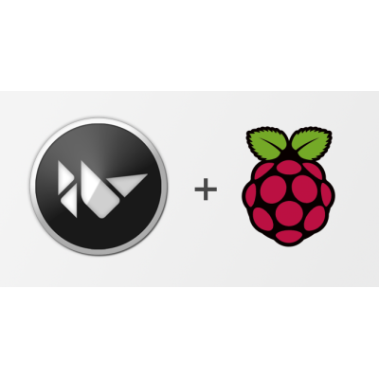
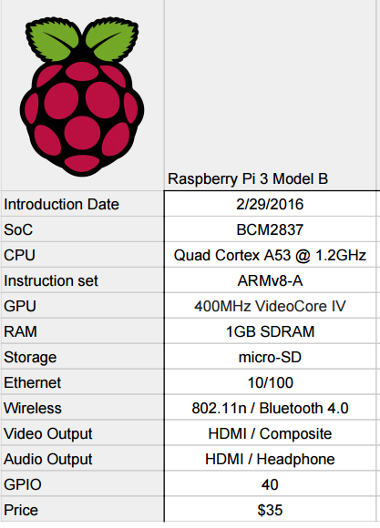

Raspberry pi 3 + Kivy

Slide 6

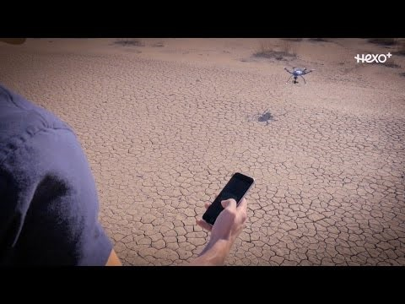
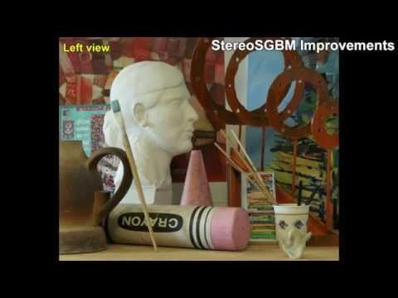
OpenCV

Slide 7
THANK YOU!
UBIQUITOUS SENSOR NETWORK LABORATORY

Slide 8
Any Questions ?
UBIQUITOUS SENSOR NETWORK LABORATORY

